Slide 1
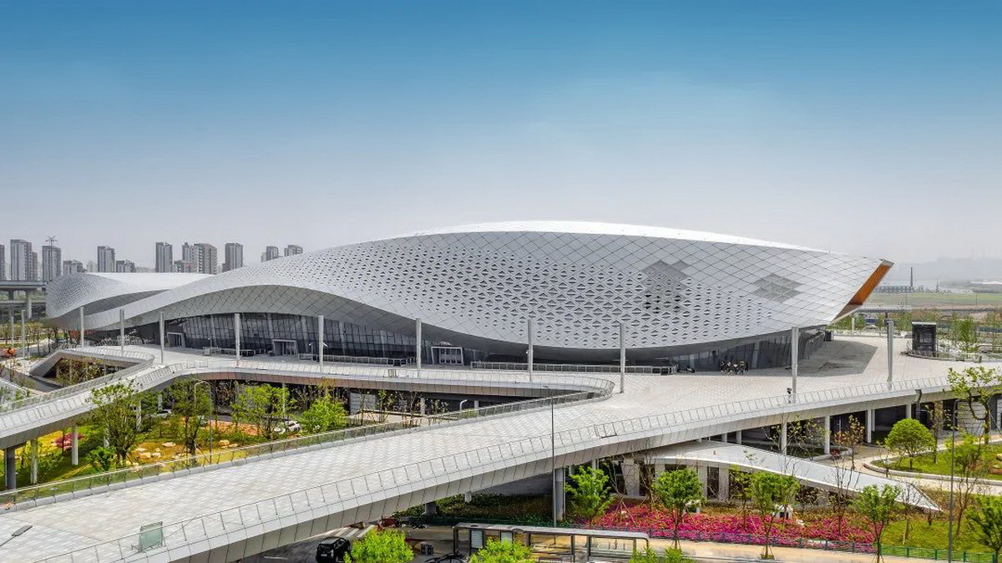
CR Assignment_1
Façades that inspired my design
The Ningbo Olympic Sports Center
Building Skin Patterns Generated by Curve Interference.
Shows a sense of dynamic elegance, akin to a butterfly gracefully dancing by the riverside.

Slide 2
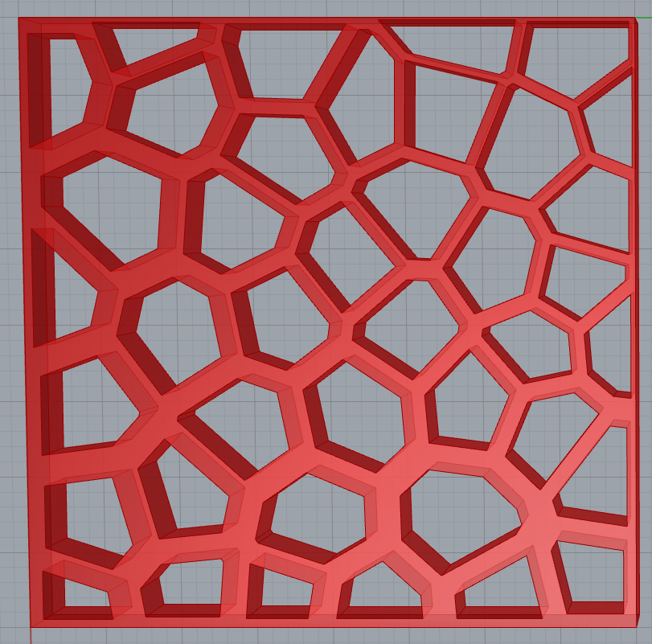
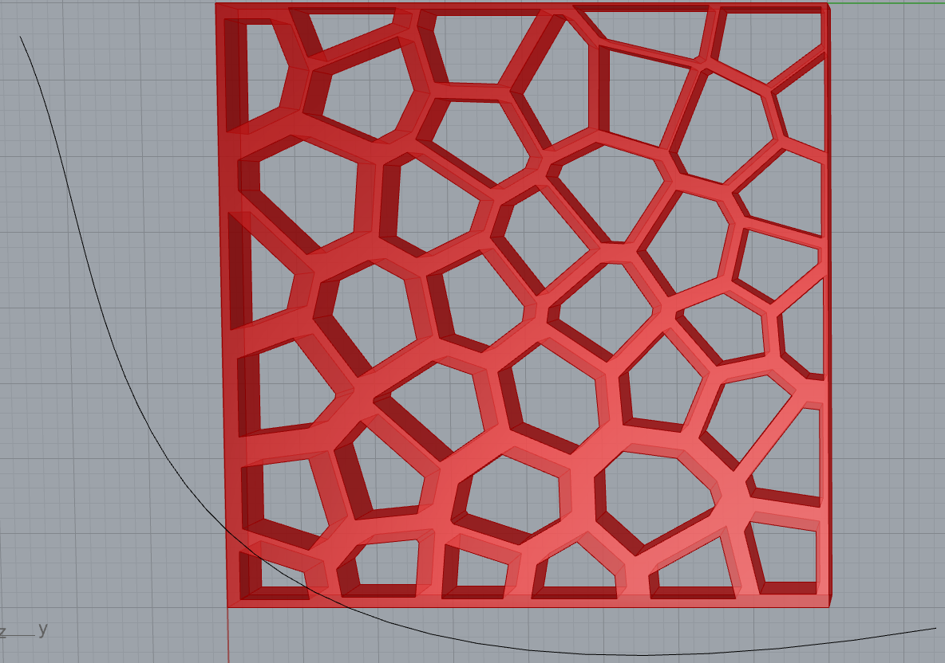
CR Assignment_1
My 3D_model design
Using Curve Interference to add a sense of dynamism.
Using “populate geometry” and “Voronoi” tools to create random patterns, showcasing uniqueness and individuality.
Starting with a broader base and slimmer
upwards, symbolizing a grounded and
progressive character.

Slide 3
CR Assignment_1
My 3D_model design
The scale of model is 1:1 (400*400*36 mm in grasshopper)
The using of Curve Interference and random seeds make it easy to create ‘similar but not same’ models.
Thicker middle and thinner edges, as well as
a thicker lower portion and a thinner upper
part, follow the principles of structural
mechanics.
The larger openings at the top provide the
building with improved natural lighting.

Slide 4
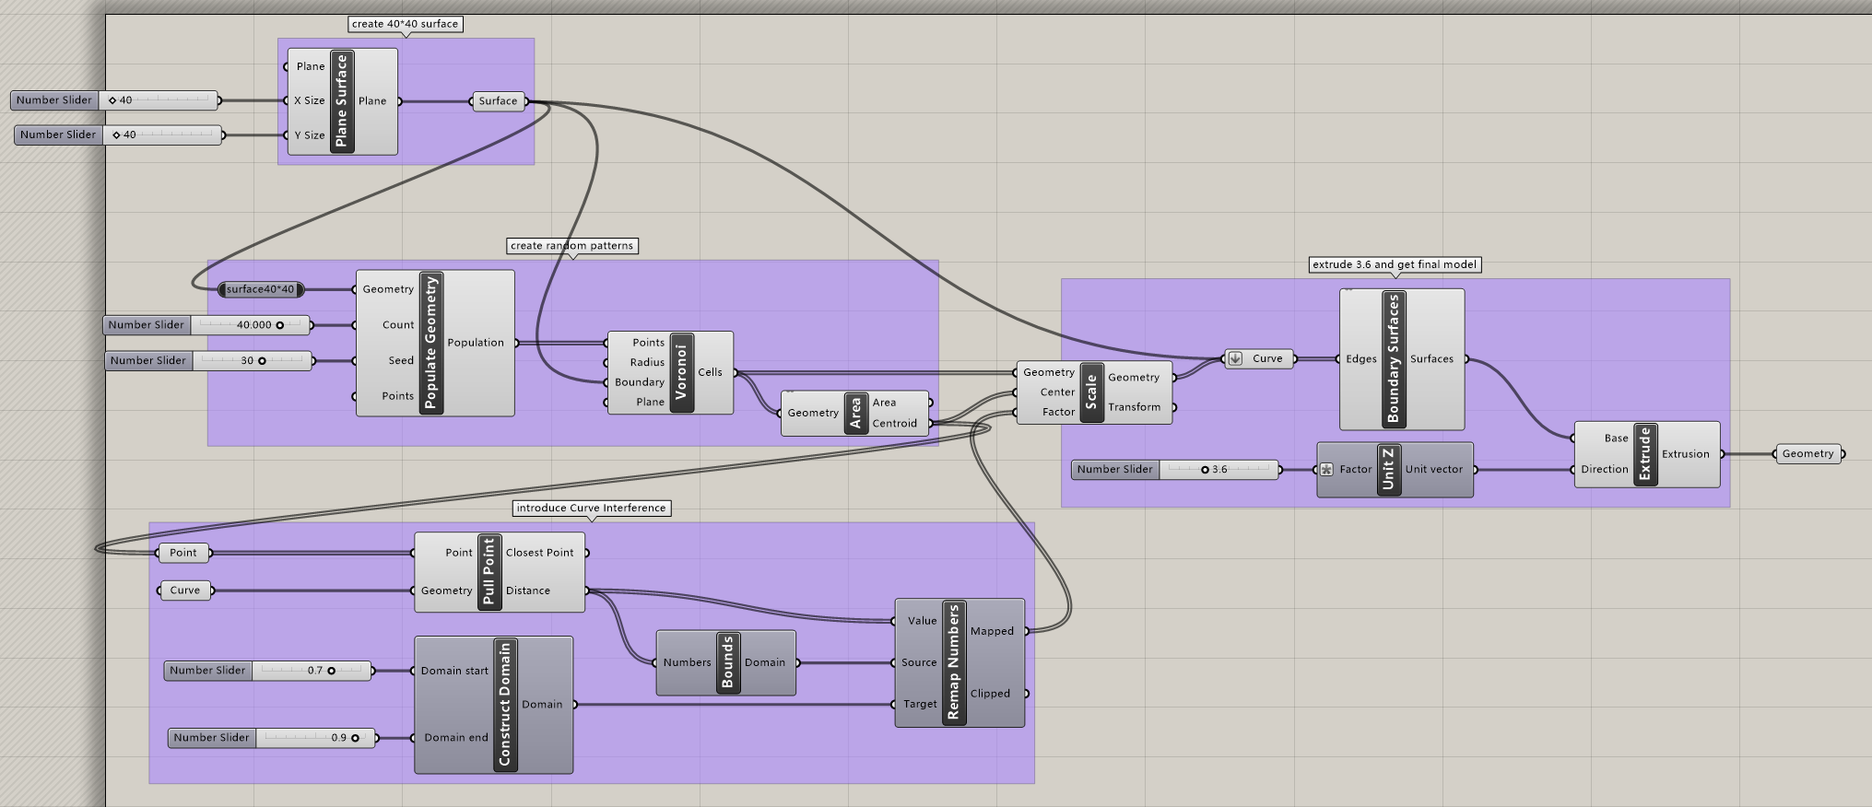
CR Assignment_1
My 3D_model design process
The process of creating model.
The scale of model is 1:10 (40*40*3.6 unit in grasshopper)
By changing the seed of Populate Geometry, a different model can be obtained easily.

Slide 5
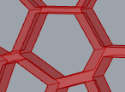
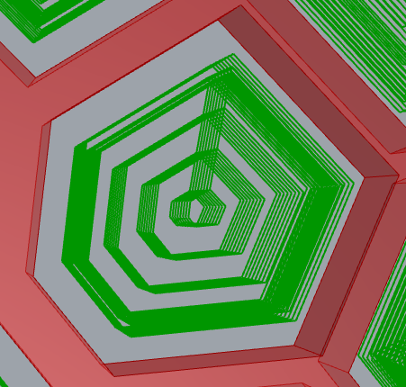

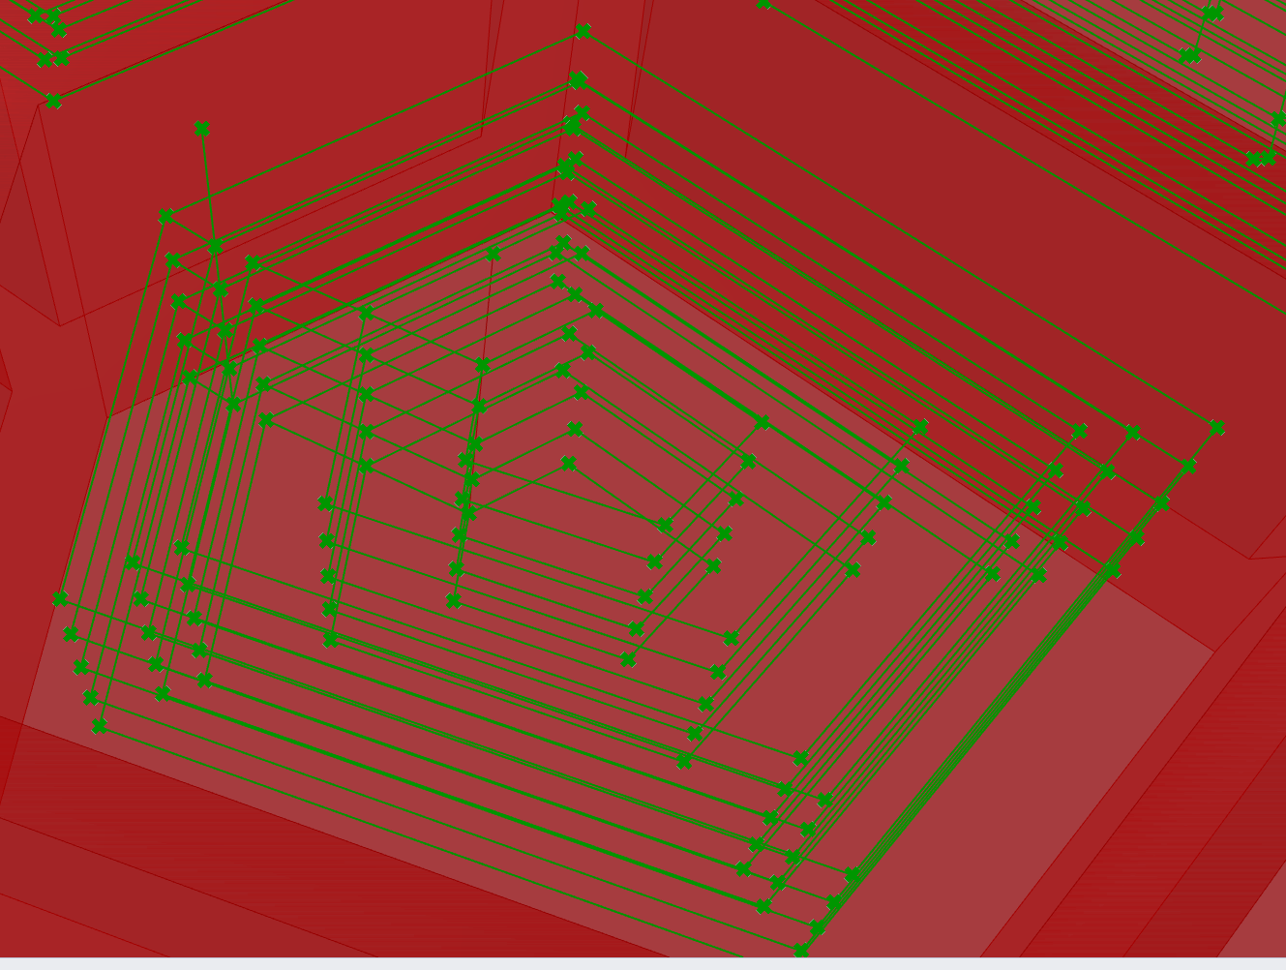
CR Assignment_2
My milling approach
1. Pattern-by-Pattern Milling:
The model is first rough milled and then fine milled.
2. Layered Milling from Inside Out:
Path starting from the inner and progressing outward.
3. Offset parameter:
8 mm offset at beginning points for safety.
4. Rough Milling Inner Layers, Fine Milling strategy：
Fine milling, each time mill 0.2*18mm.
Rough milling, three rounds per pattern, covering the entire area
Single pattern
Rough milling path
Fine milling path
Milling path and offset

Slide 6
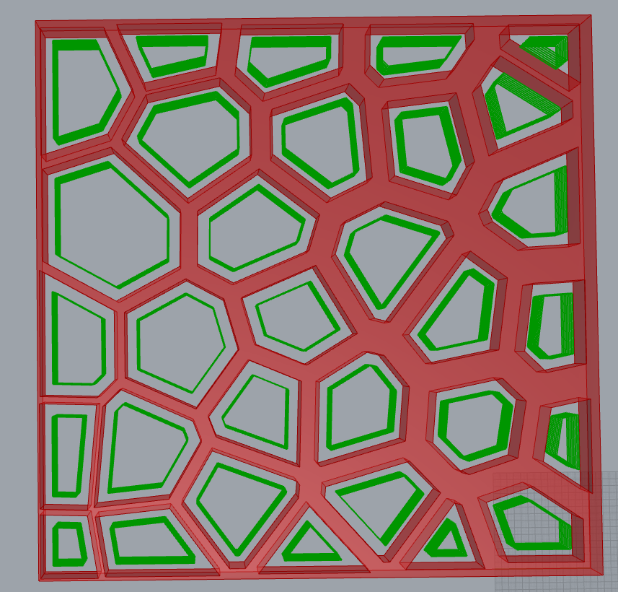
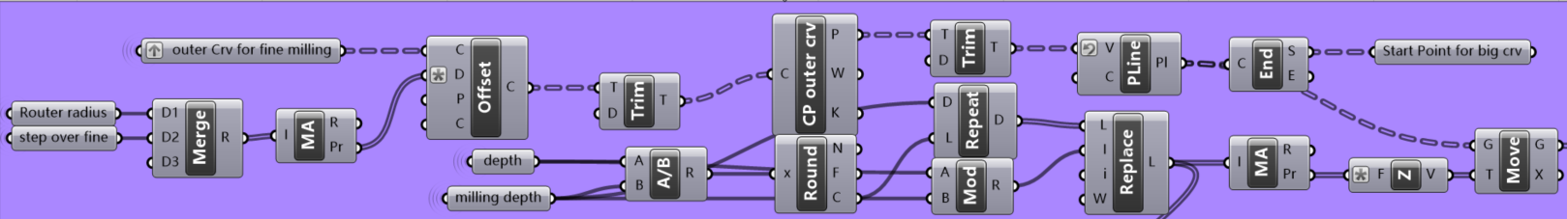
CR Assignment_3
Code milling strategy- fine milling
Each pattern is finely milled once to shape the profile.
Step over fine is 0.2 * D = 0.2 * 18 = 9 mm
The structure and milling path

Slide 7
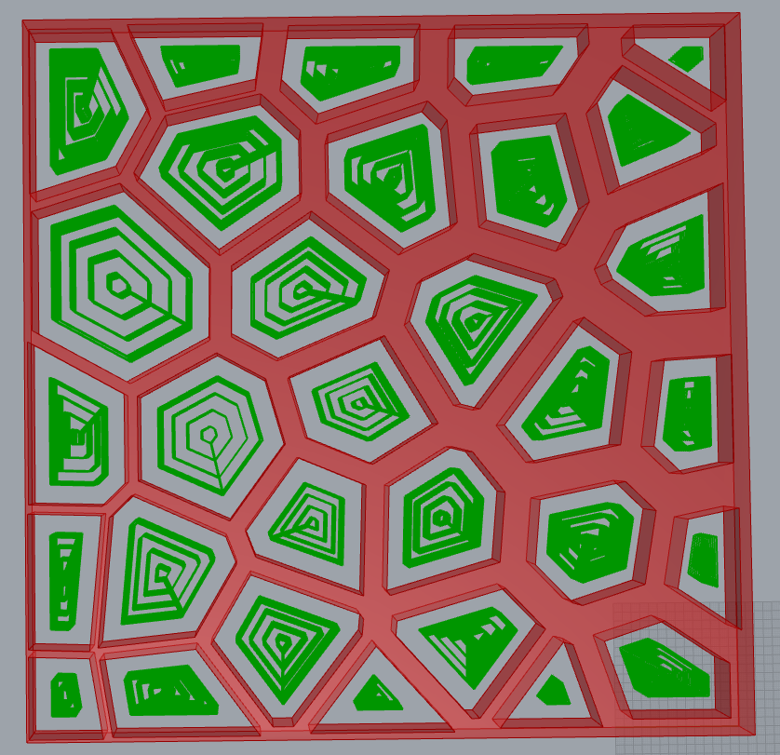
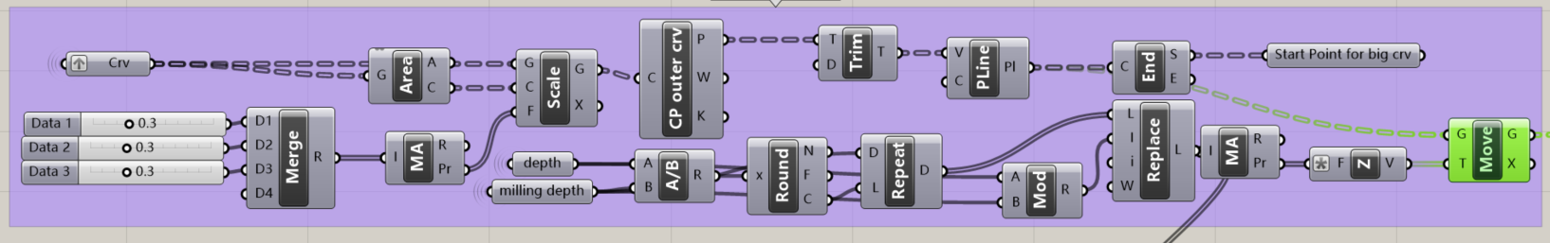
CR Assignment_3
Code milling strategy- rough milling
Smaller parts are set a path onlybecause their roughing paths are too short
After calculation, the remaining part needs to be rough milled 1 to 4 times, so it is scaled up 4 times to get tough milling path(0.15,0.3,0.3,0.3).
The structure and rough milling path

Slide 8
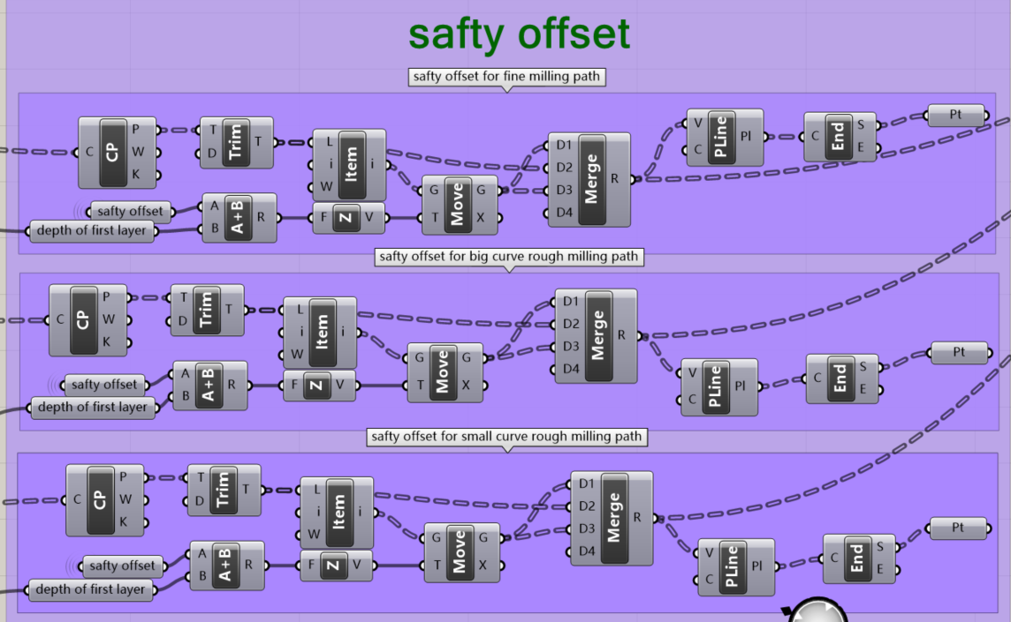
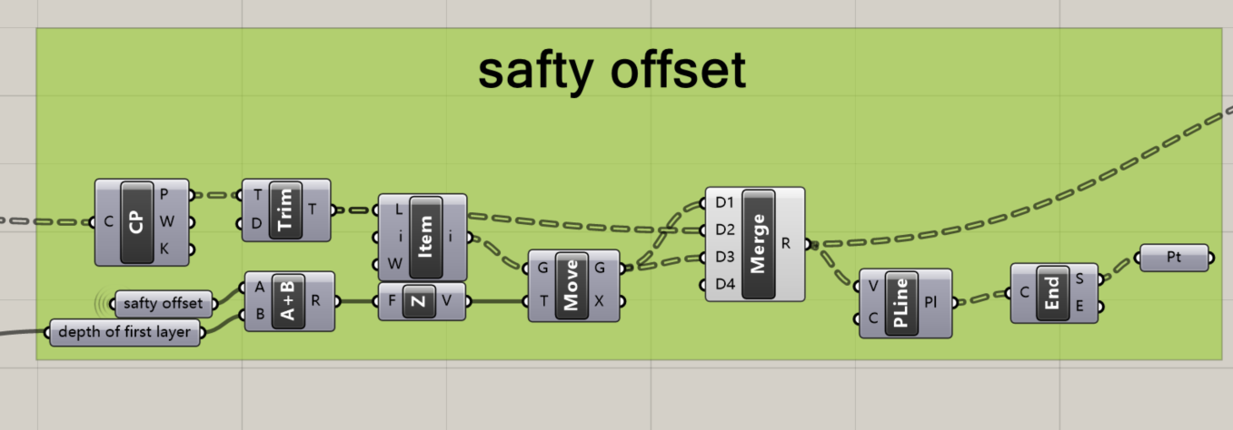
CR Final Assignment
Code adjust
After adjusting the data structure, the safety offset can be set only once instead of three.
New milling path
original milling path

Slide 9
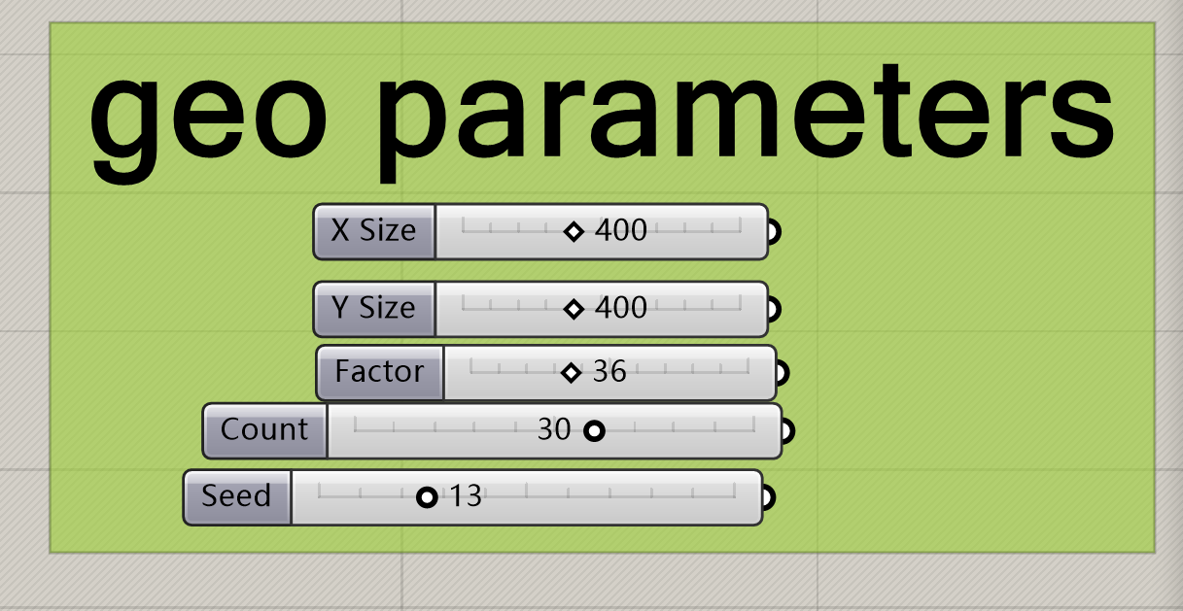
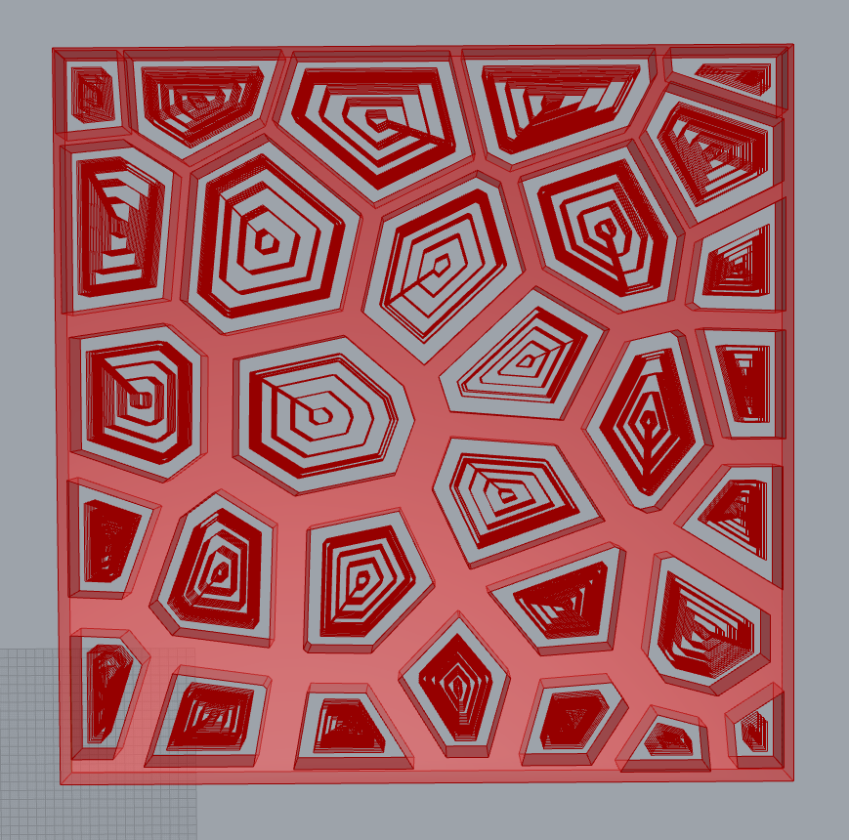
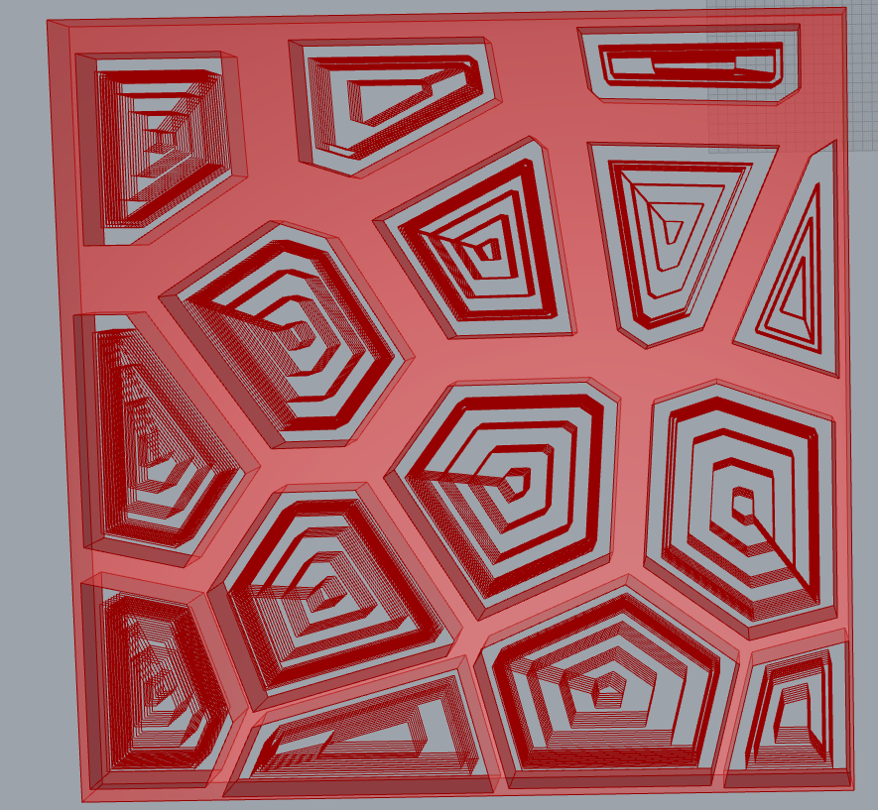
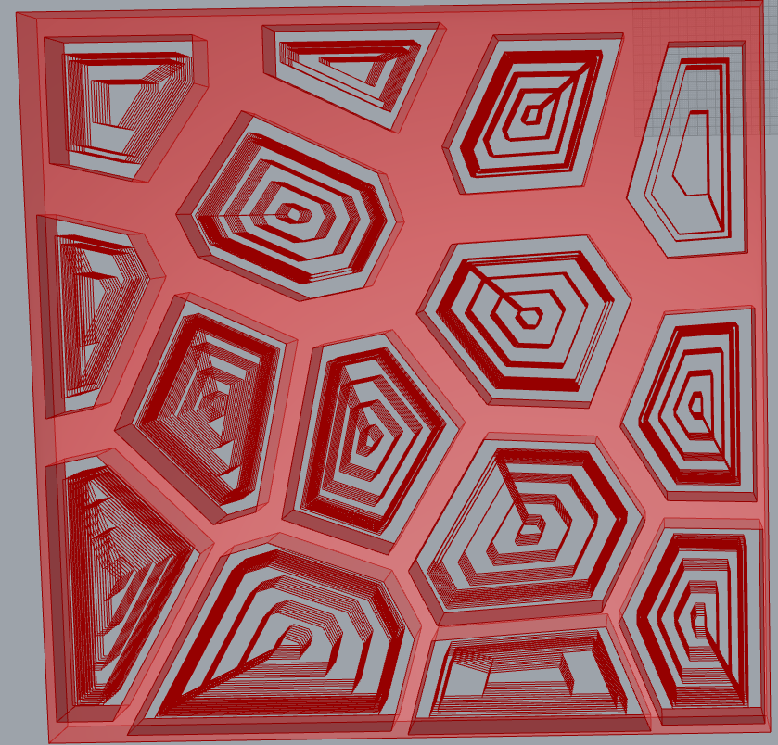
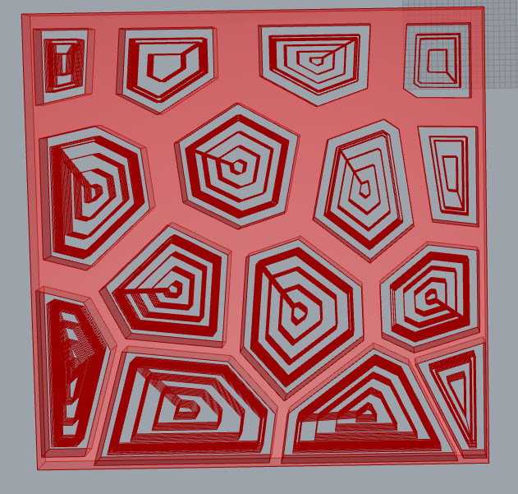
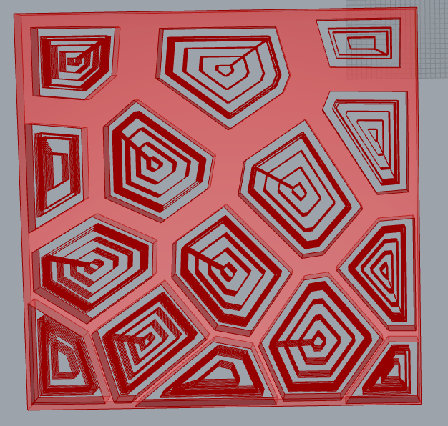
CR Final Assignment
Results show
After check, with count of 30 and random seeds 10, 13 and 24, the code can create three different structures that all different with each other and work well with robot.
Count and seed below can be found in geo parameters:
If we choose a smaller number of random graphs, for example, when the count is 15, then nearly half of random seeds can create different structure and all work well with robot.
Of course, we can also easily change the curves used to interfere with the dynamics.
Geo parameters
Counts=15 and random seed = 15, 12, 3, 17…..
Counts=30 and random seed = 10

Slide 10
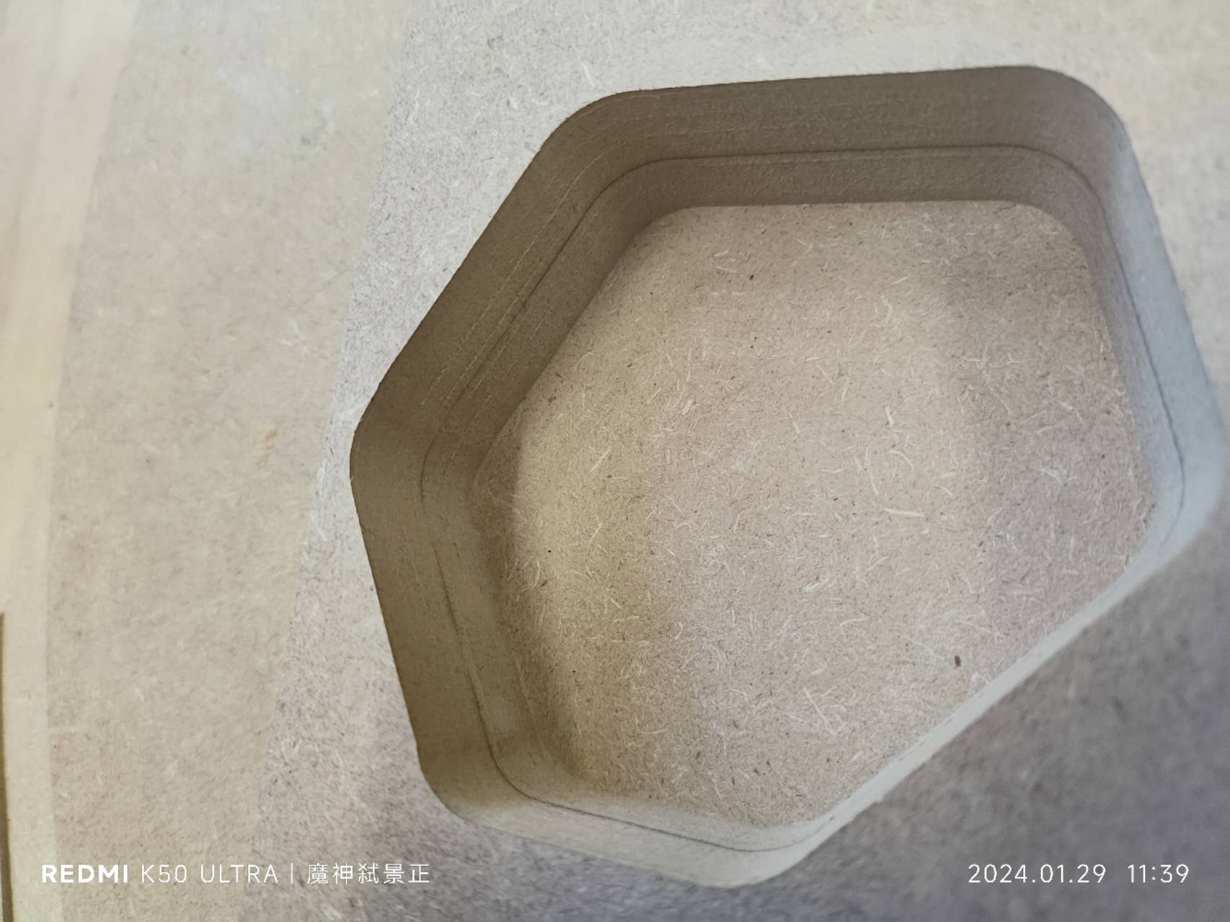
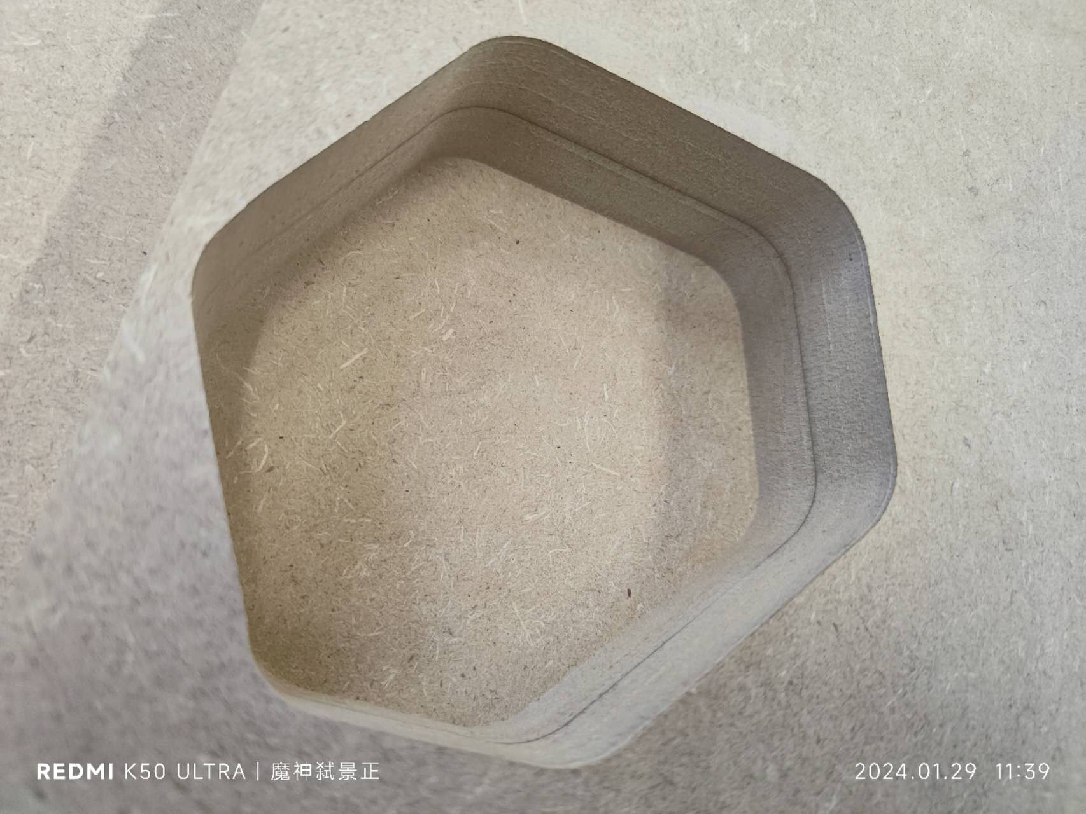
CR Final Assignment
Results show
The first pattern is selected for testing.
The results are very satisfactory, both at the under surface and at the boundary of structure.
The results of test milling

Slide 11

CR Final Assignment
The PPT end here

